Slide 2
CONTENTS WEATHER AND CLIMATE SEASONS IN INDIA WINTER SUMMER MONSOON
OUR CLIMATE

Slide 3
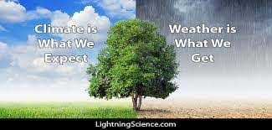
WEATHER IS THE DAY –TO-DAY CONDITIONS OF THE AIR AT A PARTICULAR PLACE. IT IS A TEMPORARY CHANGE. IT REMAINS FOR CITY /TOWN.
WEATHER

Slide 4
CLIMATE OF A PLACE IS THE PATTERN OF WEATHER CONDITIONS OVER A LONG PERIOD,FOR ABOUT 30-40 YEARS. IT IS A PERMANENT CHANGE. IT REMAINS FOR A COUNTRY. TEMPERATURE AND RAINFALL ARE THE TWO ELEMENTS THAT AFFECT CLIMATE.
CLIMATE

Slide 5
THREE SEASONS IN INDIA SUMMER WINTER MONSOON
SEASONS OF INDIA

Slide 6
Winter, occurring from December to February. Summer or pre-monsoon season, lasting from March to May. Monsoon or rainy season, lasting from June to September
Seasons in India

Slide 7
https://youtu.be/A_LOsCaRzNA

Slide 8
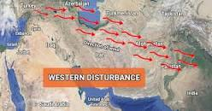
A western disturbance is an extratropical storm originating in the Mediterranean region that brings sudden winter rain to the northwestern parts of the Indian subcontinent. It is a non-monsoonal precipitation pattern driven by the westerlies. ... western disturbances are more frequent and strong in winter season.
WINTER

Slide 9
WINTER

Slide 10
SUMMER

Slide 11
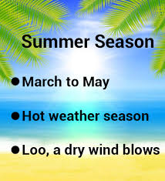

Slide 13
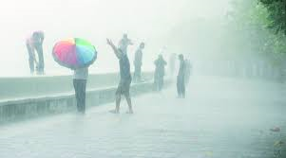
MONSOON

Slide 14
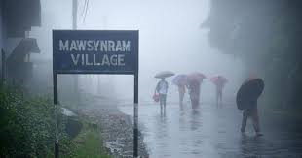
WETTEST PLACE

